Slide 1

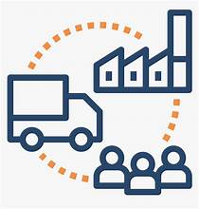

Supply Chain Analysis
Powered by DEPI

Slide 2


Understanding the Data
Data Cleaning Process
Dashboards & Key Insights
Agenda:
Conclusion

Slide 3

What is the Data?
Dataset Overview:
Supply Chain dataset with key columns such as:
Product Type, Shipping Type, Shipping cost, Lead time.
Order Time, Shipping Time, and more
Provides comprehensive manufactures data for analysis.
Purpose of the Analysis:
To explore insights related to:
Descriptive Analysis, Sales and Revenue Analysis.
Demographic distributions and workforce trends

Slide 4

Data Cleaning Process

Slide 5

1) Data Cleaning

Slide 6
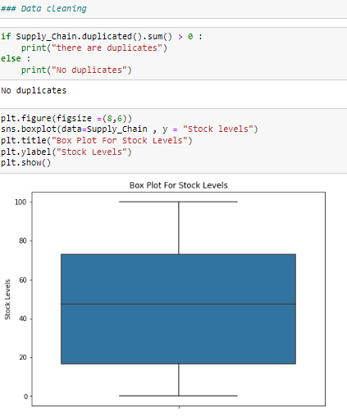
Overview of the Data

Slide 7
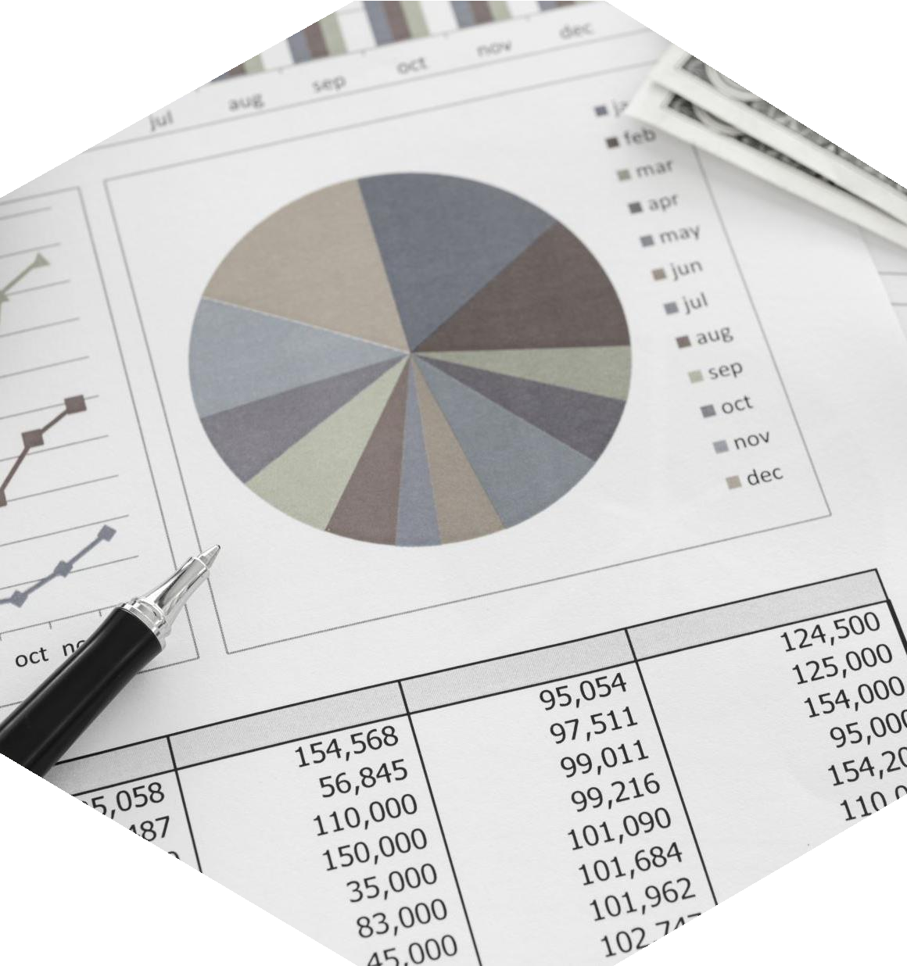
2) Charts by Python :

Slide 8
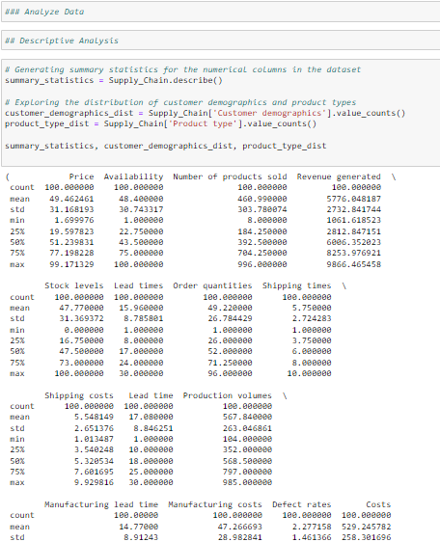
Descriptive Analysis

Slide 9
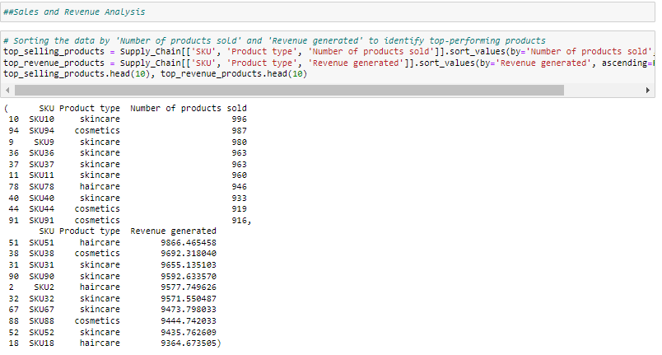
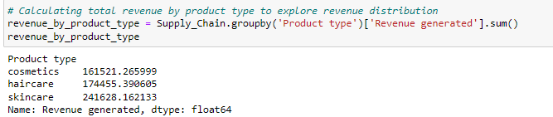
Sales and Revenue Analysis

Slide 10
Stock Levels vs. Availability Analysis

Slide 11
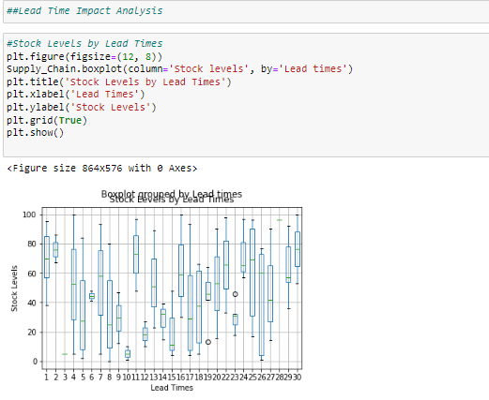
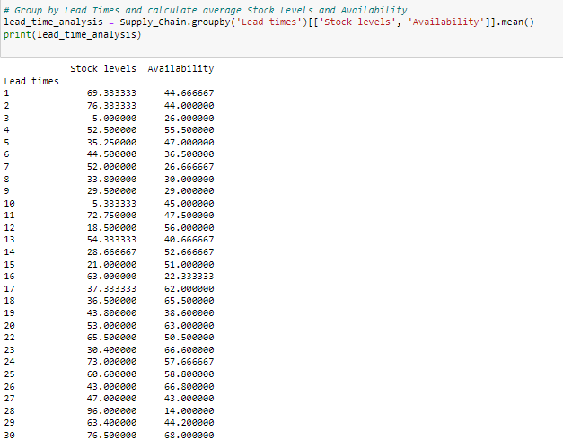
Lead Time Impact Analysis

Slide 12
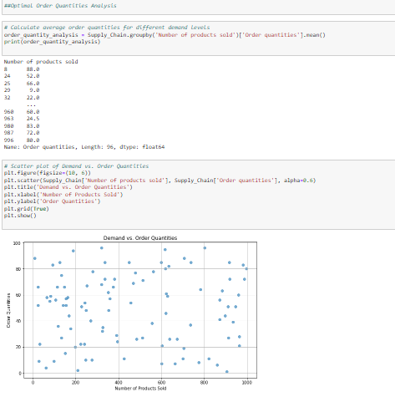
Optimal Order Quantities Analysis

Slide 13
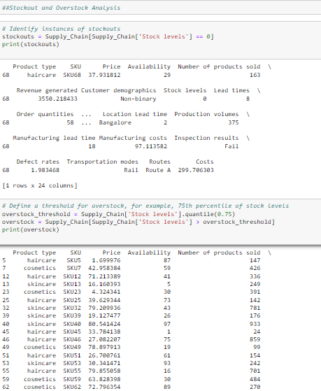
Stockout and Overstock Analysis

Slide 14
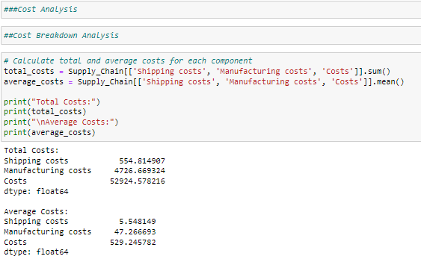
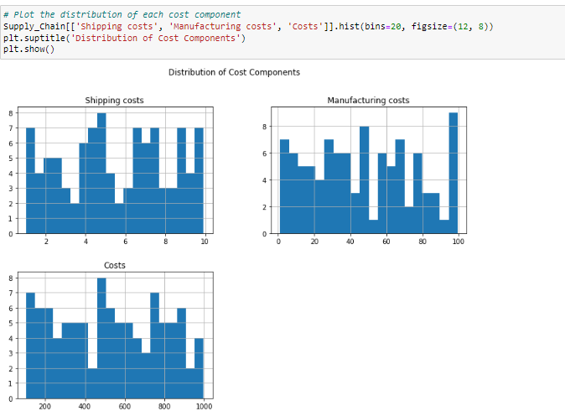
Cost Analysis

Slide 15
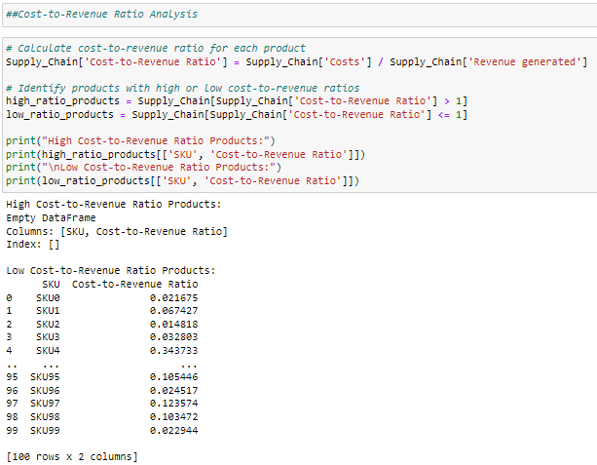
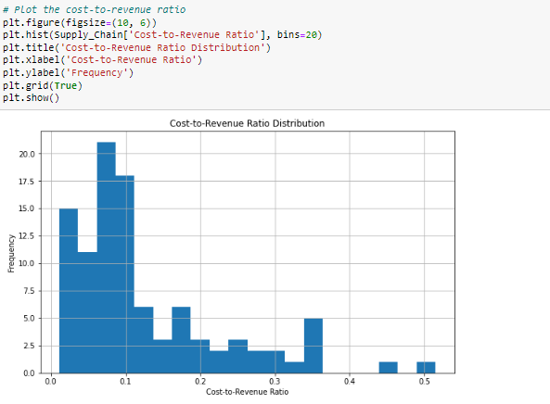
Cost-to-Revenue Ratio Analysis

Slide 16
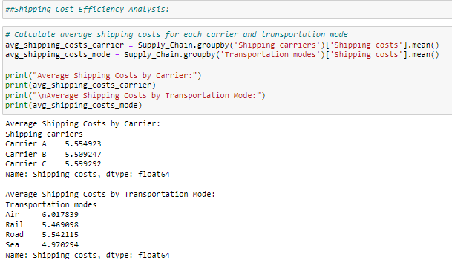
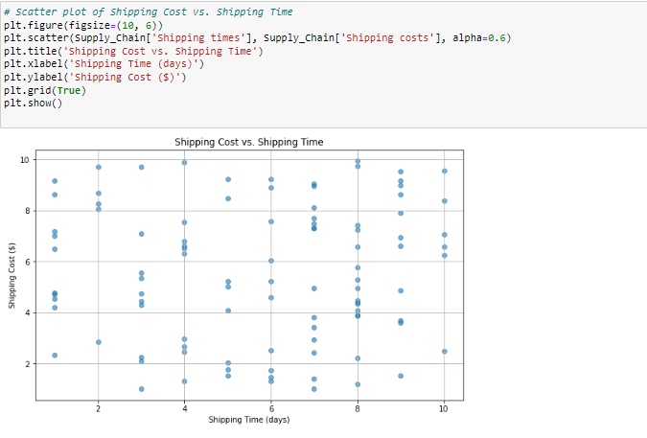
Shipping Cost Efficiency Analysis

Slide 17
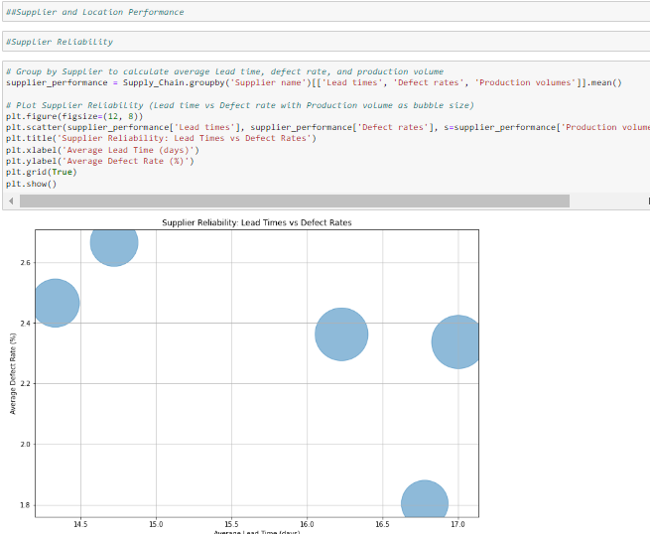
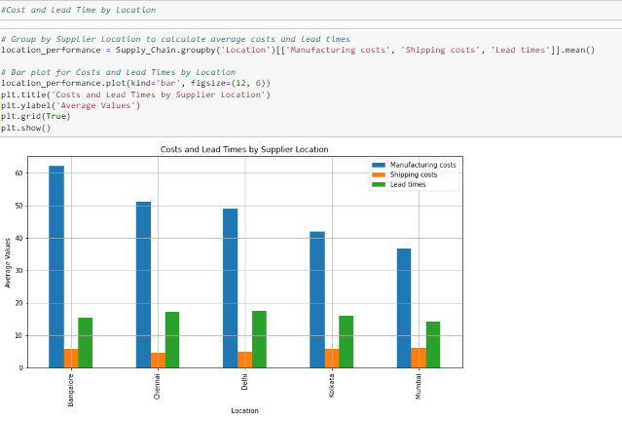
Supplier and Location Performance

Slide 18
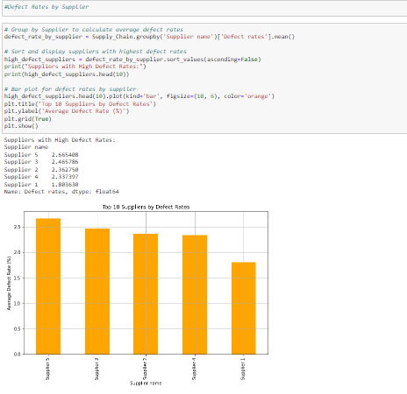
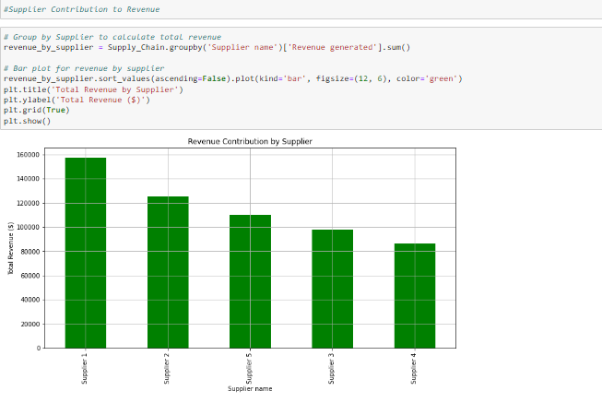
Defect Rates by Supplier

Slide 19
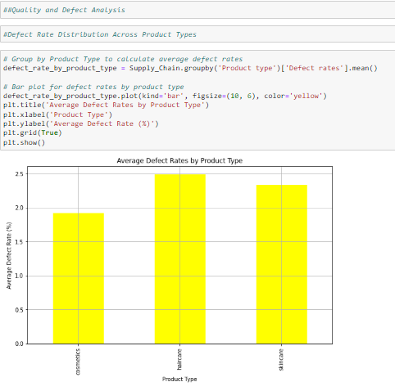
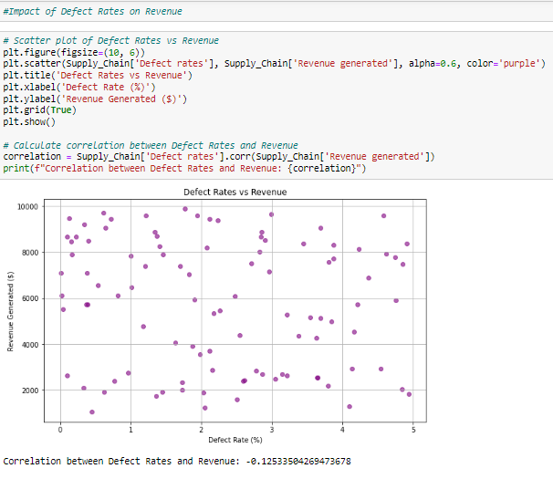
Quality and Defect Analysis

Slide 20
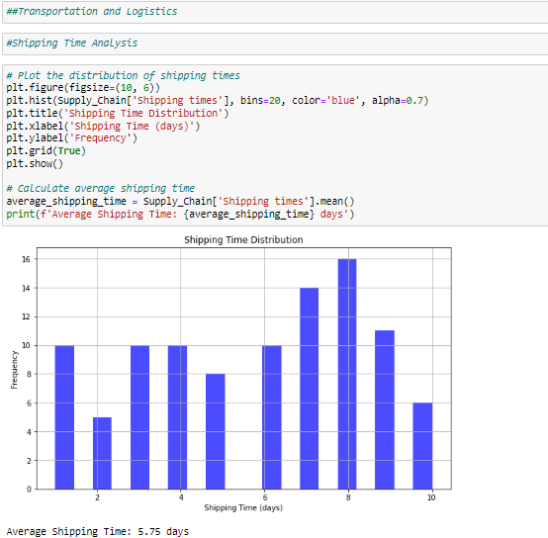
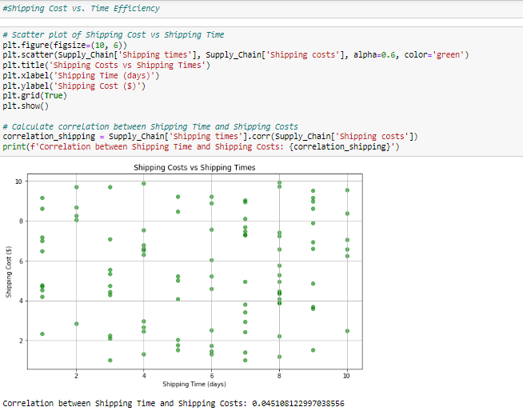
Transportation and Logistics

Slide 21
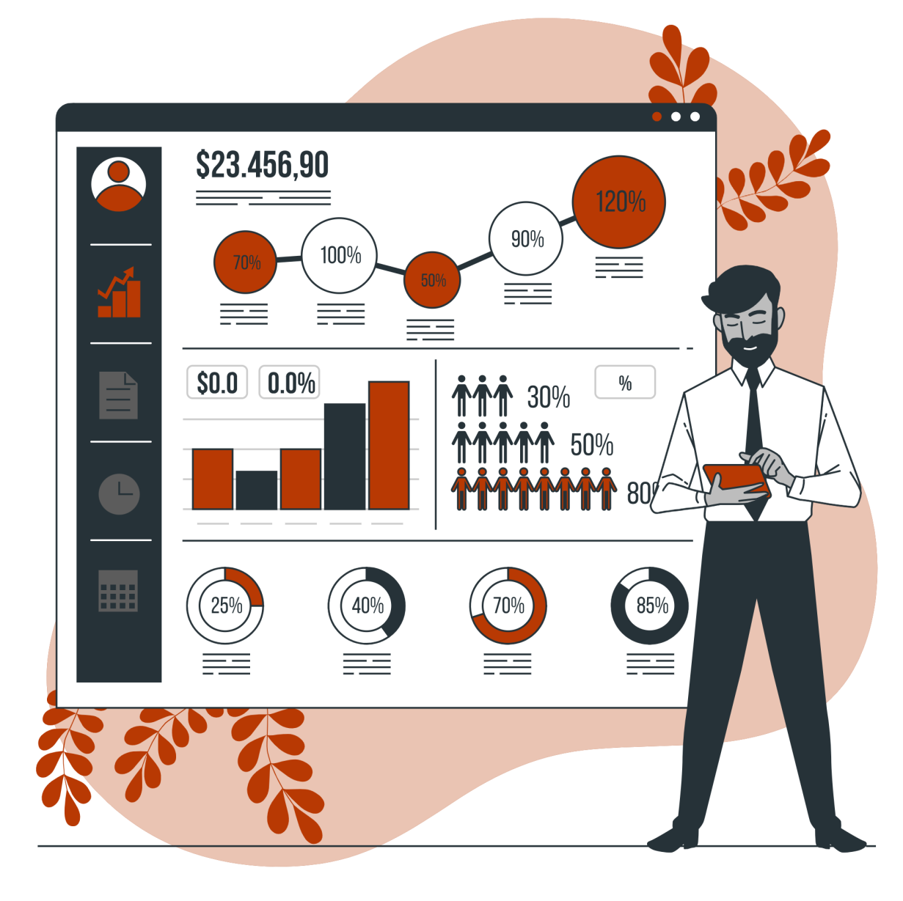
Dashboards & Insights
By: Tableau

Slide 22
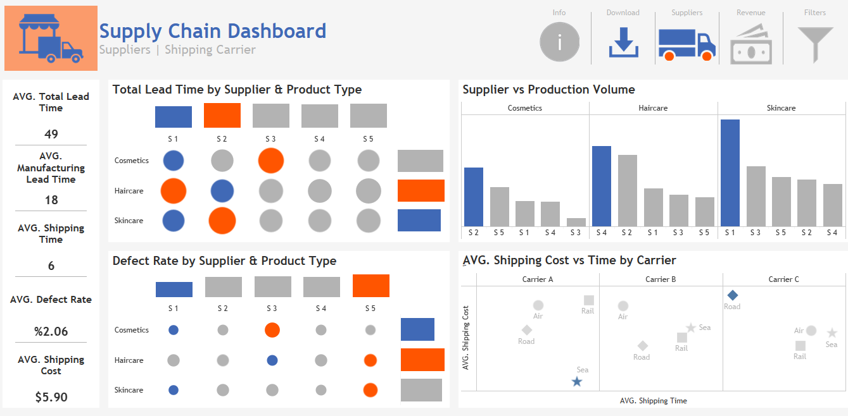

Slide 23
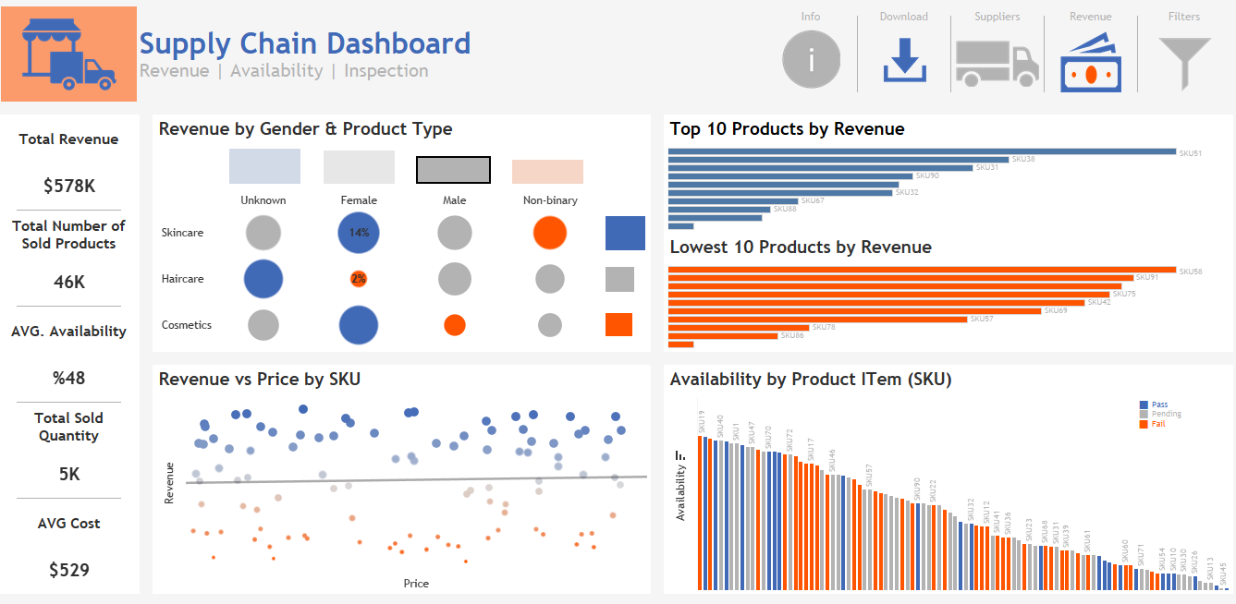

Slide 24

Summary
Cleaned and prepared the Supply Chain dataset for analysis.
Built dashboards to visualize key metrics .
Provided insights to help improve Supply Chain Performance.
Successful collaboration by Team across all stages of the project.

Slide 25
Thank you!
We appreciate your time and attention.
Created By :
Mohammed Reda
Mohammed Mohktar

